Slide 1


MINI PROJECT
Health Monitoring System using Machine Learning Techniques and QFD
Reg.No: 20MIA1117
Name: Pillaram Manoj
Guide: Dr. Valarmathi Sudhakar

Slide 2

OUTLINE
INTRODUCTION
LITERATURE REVIEW
SCOPE AND PROBLEM STATEMENT
DATASET
RESEARCH CHALLENGES
RESEARCH OBJECTIVE
LIMITATIONS
FUTURE WORK
CONCLUSION
GUIDE APPROVAL
REFERENCES

Slide 3
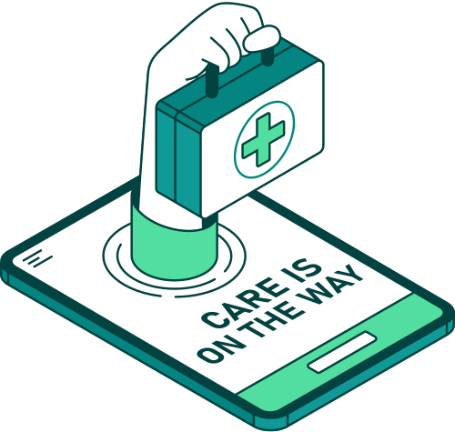
Introduction
The use of machine learning into health monitoring systems represents a significant leap in healthcare technology. Machine learning algorithms can evaluate massive volumes of health data, revealing patterns and trends that humans may not see right away.
This feature enables health monitoring systems to generate more accurate predictions about prospective health problems, resulting in earlier identification and prevention.
This predictive ability is especially important in managing chronic illnesses, because early intervention can significantly improve a patient's quality of life.
Quality Function Deployment (QFD) is a tool used in the creation of health monitoring systems to ensure that the system's features and functions meet the unique demands of patients and healthcare practitioners.

Slide 4
Introduction
QFD includes the customer's input into the design and development process, resulting in solutions that provide maximum value. By concentrating on the user's demands and preferences, QFD assists in the creation of a system that is not only functional but also fulfills the highest quality and reliability criteria.
The main goal of this study is to increase the accuracy and efficiency of health monitoring systems, making them more dependable and useful tools for both patients and healthcare practitioners. By integrating modern machine learning techniques and QFD, the study seeks to create a system that not only accurately anticipates health risks but also meets the requirements and expectations of users.
The work also includes the development of a user-friendly interface to guarantee that the system is easily accessible and used by a wide variety of people.

Slide 5
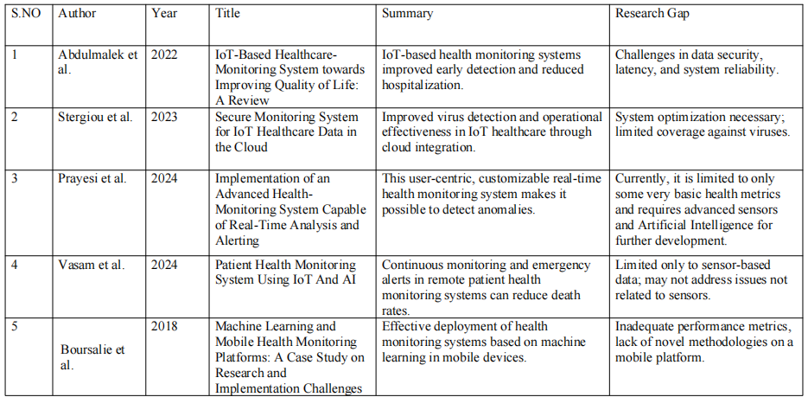

Literature Review

Slide 6
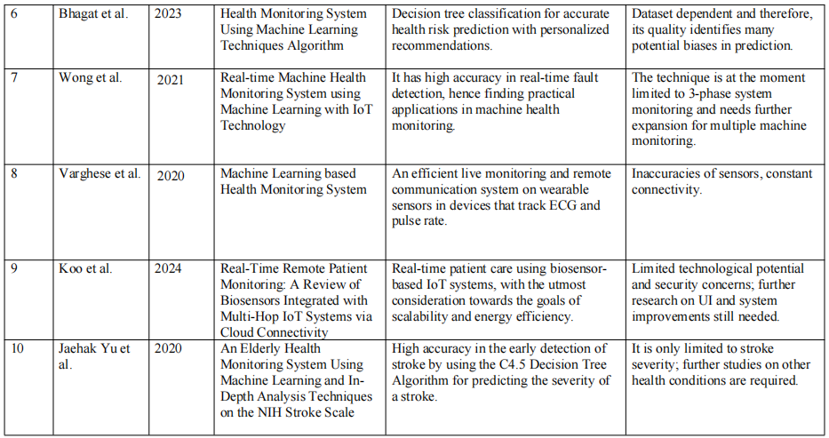
Literature Review

Slide 7
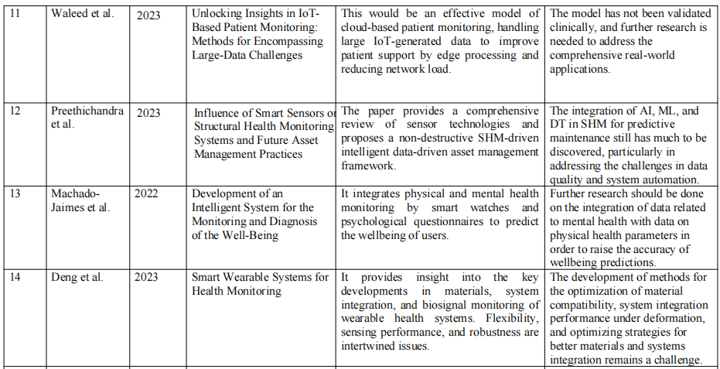
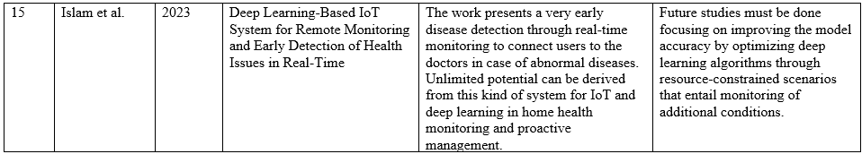
Literature
Review

Slide 8
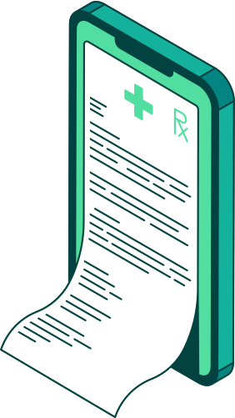
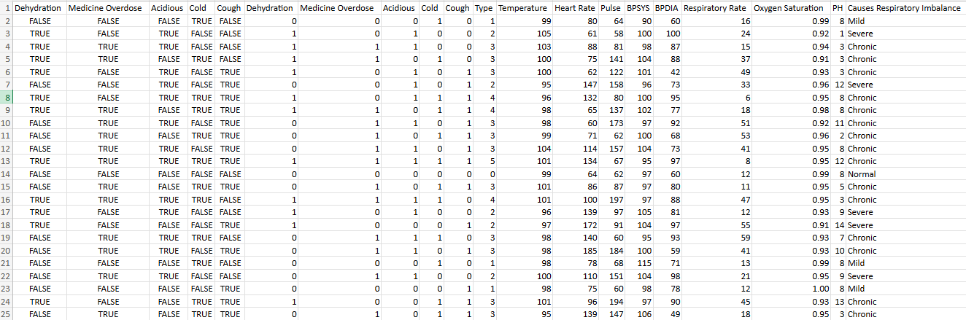
Dataset

Slide 9
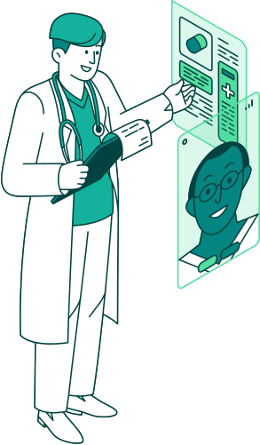
Scope & Problem statement
Scope:
The present study focuses on the optimization of a health monitoring system by the usage of Machine learning techniques and Quality function deployment.
This includes evaluating multiple machine learning models in terms of their performance, integration of the developed models into a user-friendly interface, and utilization of QFD to confirm that the proposed system satisfies all the requirements expressed by patients and healthcare providers.
Real-time monitoring for critical health parameters, timely interventions related to chronic disease management and overall patient care are also addressed in this study.
Problem Statement:
Even with improvements in health monitoring systems, predictive accuracy and reliability remain major challenges.
Most of the existing systems lack efficient processing capacity and analysis for such huge volumes of data or certain user requirements.
This study tries to fill the gaps by examining if there is any scope to develop an advanced machine learning algorithm-based health monitoring system with improved predictive accuracy, reliability, and user-friendliness with QFD integration.

Slide 10
Reseach challenges
User Interface Design:
Designing an intuitive and accessible user interface is a difficult task, because the solution must cater to a broad range of schemas of the effective patient agreeing to treatment levels with different users. The interface has to be functionally and user acceptably friendly for reproducing it within users.
Data Security and Privacy:
It is very important to protect sensitive health data. The study aimed at pointing out the potential problems of imposing strict security measures that may slow down access to and use of overall systems pertaining to the effectiveness of patient health servicing
Model Selection and Evaluation:
To choose the best machine learning model, it is necessary to test each of the various models.
The research should therefore compare and contrast different models like Random Forest, XGBoost, and AdaBoost, among others in terms of predictive accuracy on healthcare data.
Real-Time Data Processing:
This is another huge challenge: how to ensure real-time processing and analysis of data by the health monitoring system.
It actually calls for the optimization of algorithms concerning huge datasets in terms of their efficiency, accuracy, and latency.

Slide 11

Reseach Objective
The primary objective is to create an optimized health monitoring system with an advanced machine learning techniques and Quality Function Deployment to enhance predictive accuracy, reliability and user satisfaction. It specifically aims to:
Identify and evaluate the best machine learning models that can be used in analyzing health data in real-time.
Integrate QFD into the system design to ensure it satisfies user needs and preferences.
Design a simple and user-friendly interface that gives access to all health monitoring and managing tools.

Slide 12

Limitations
Model generalization: The study focused on some machine learning models, but there is the likelihood that they might not generalize well to health data or patient populations in general. Further studies may need to be conducted in order for the models to be fitted in different contexts.
Real-time implementation: Real-time data processing may be limited by the hardware limitations or network infrastructure of the setting itself, further hampering the system performance across settings.
User Acceptance: Despite efforts to make the interface user-friendly, there could be difficulties in gaining wide acceptance and usage among diverse patients with low technological literacy.

Slide 13
Futurework
Comprehensive Health Monitoring: Future research with this system can further extend from just parameters such as heartbeats and blood pressure to other vital metrics regarding a person's health, such as respiratory rate, body temperature, and mental health indicators, thus becoming much more comprehensive with monitoring general health.
IoT Integration: Integrate this with IoT devices in a way that continuous data accumulation through these devices gets enabled and seamlessly integrated into other health-monitoring tools for efficient real-time location tracking of the patient and its management.

Slide 14
Conclusion
The proposed system shows the potential of health monitoring systems which could be further enhanced using advanced methods of machine learning and Quality Function Deployment (QFD).
The research observes the models Random Forest, Decision Tree, AdaBoost, and XGBoost in prediction processes with a perfect accuracy of 100%. Ensuring that QFD has been implemented in the system that satisfies the expectations of both patients and healthcare service providers, while providing a user-friendly interface promotes access and use.
The study also identifies that there are limitations inherent within the study, especially in terms of generalized models and real-time application. It is still a crucial step toward future improvement in the customized health care industry.
This system will provide a potential framework for better patient outcomes by enabling for proactive management along with the providing of outstanding healthcare.

Slide 15
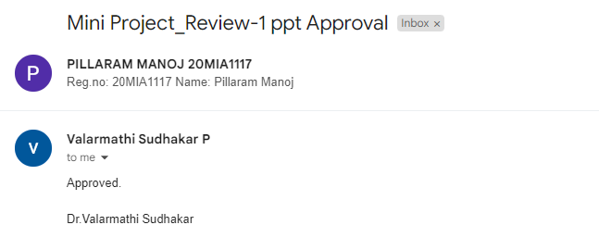
Guide Approval picture

Slide 16
Reference
[1] Abdulmalek, S., Nasir, A., Jabbar, W. A., Almuhaya, M. a. M., Bairagi, A. K., Khan, M. A., & Kee, S. (2022). IoT-Based Healthcare-Monitoring System towards Improving Quality of Life: A Review. Healthcare, 10(10), 1993. https://doi.org/10.3390/healthcare10101993
[2] Stergiou, C. L., Plageras, A. P., Memos, V. A., Koidou, M. P., & Psannis, K. E. (2023). Secure monitoring system for IoT healthcare data in the cloud. Applied Sciences, 14(1), 120. https://doi.org/10.3390/app14010120
[3] Prayesi, K. P., Azami, S., Kushwah, V. R. S., Nayak, S., Yerasuri, S., Sumallika, T., & Gupta, M. (2024). Implementation of an Advanced Health-Monitoring System Capable of Real-Time Analysis and Alerting. CC 2023. https://doi.org/10.3390/engproc2024062016
[4] Vasam, V. K., Shaik, A., Tolchuri, S. L. M., Rachamadugu, S. S., Krishna, H., Chandra, G. R., & Anand, D. (2024). Patient Health Monitoring System Using IOT And AI. IPDIMS 2023. https://doi.org/10.3390/engproc2024066031
[5] Boursalie, O., Samavi, R., & Doyle, T. E. (2018). Machine Learning and Mobile Health Monitoring Platforms: A case study on research and Implementation challenges. Journal of Healthcare Informatics Research, 2(1–2), 179–203. https://doi.org/10.1007/s41666-018-0021-1

Slide 17
Reference
[6] Bhagat, R., & Patil, P. (2023). Health monitoring system using machine learning techniques algorithm. International Journal for Research in Applied Science and Engineering Technology, 11(6), 2786–2881. https://doi.org/10.22214/ijraset.2023.54228
[7] Wong, T. K., Mun, H. K., Phang, S. K., Lum, K. L., & Tan, W. Q. (2021). Real-time Machine Health Monitoring System using Machine Learning with IoT Technology. MATEC Web of Conferences, 335, 02005. https://doi.org/10.1051/matecconf/202133502005
[8] Sheela, K. G., & Varghese, A. R. (2020). Machine Learning based Health Monitoring System. Materials Today Proceedings, 24, 1788–1794. https://doi.org/10.1016/j.matpr.2020.03.603
[9] Habehh, H., & Gohel, S. (2021). Machine learning in healthcare. Current Genomics, 22(4), 291–300. https://doi.org/10.2174/1389202922666210705124359
[10] Uddin, R., & Koo, I. (2024). Real-Time Remote Patient Monitoring: A Review of Biosensors Integrated with Multi-Hop IoT Systems via Cloud Connectivity. Applied Sciences, 14(5), 1876. https://doi.org/10.3390/app14051876

Slide 18
Reference
[11] Waleed, M., Kamal, T., Um, T., Hafeez, A., Habib, B., & Skouby, K. E. (2023). Unlocking Insights in IoT-Based Patient Monitoring: Methods for encompassing Large-Data Challenges. Sensors, 23(15), 6760. https://doi.org/10.3390/s23156760
[12] Preethichandra, D. M. G., Suntharavadivel, T. G., Kalutara, P., Piyathilaka, L., & Izhar, U. (2023). Influence of smart sensors on structural health monitoring systems and future asset management practices. Sensors, 23(19), 8279. https://doi.org/10.3390/s23198279
[13] Machado-Jaimes, L., Bustamante-Bello, M. R., Argüelles-Cruz, A., & Alfaro-Ponce, M. (2022). Development of an intelligent system for the monitoring and diagnosis of the Well-Being. Sensors, 22(24), 9719. https://doi.org/10.3390/s22249719
[14] Deng, Z., Guo, L., Chen, X., & Wu, W. (2023). Smart wearable systems for health monitoring. Sensors, 23(5), 2479. https://doi.org/10.3390/s23052479
[15] Islam, M. R., Kabir, M. M., Mridha, M. F., Alfarhood, S., Safran, M., & Che, D. (2023). Deep Learning-Based IoT system for remote monitoring and early detection of health issues in Real-Time. Sensors, 23(11), 5204. https://doi.org/10.3390/s23115204

Slide 19

THANK YOU

